Slide 1
Machine Learning Day
Cuauhtemoc Anda
Pieter Fourie

Slide 2
Machine Learning
Machine Learning
Linear
Algebra
Statistics
Optimization
Computer Science
Neuroscience
Vector Calculus
Objective
The design of computer algorithms to perform a specific task without using explicit instructions, relying on patterns in the data and inference instead.

Slide 3
Types of Learning
Supervised Learning { X , y }
Unsupervised Learning { X }
Reinforcement Learning { X , y , r }

Slide 4
Scope of this course
Supervised Learning:
Classification
Models:
Logistic Regression, Softmax Regression, Decision Tree, Random Forest
ML concepts:
Predictive Function, Cost Function, Overfitting, Cross Validation, Regularization, Bagging
Concept
explanation
+
Maths
+
R Lab
exercises

Slide 5
Sections
Machine Learning Basics
Logistic Regression
Basis Functions
Softmax Regression
Regularization
Decision Tree
Random Forest

Slide 6
The Multidimensional (Data) Space
1. Machine Learning Basics

Slide 7
General Strategy
1. Machine Learning Basics
Problem Setting
Model / Predictive Function
Cost / Loss Function
Parameter Estimation (Learning)
Model Validation / Generalization

Slide 8
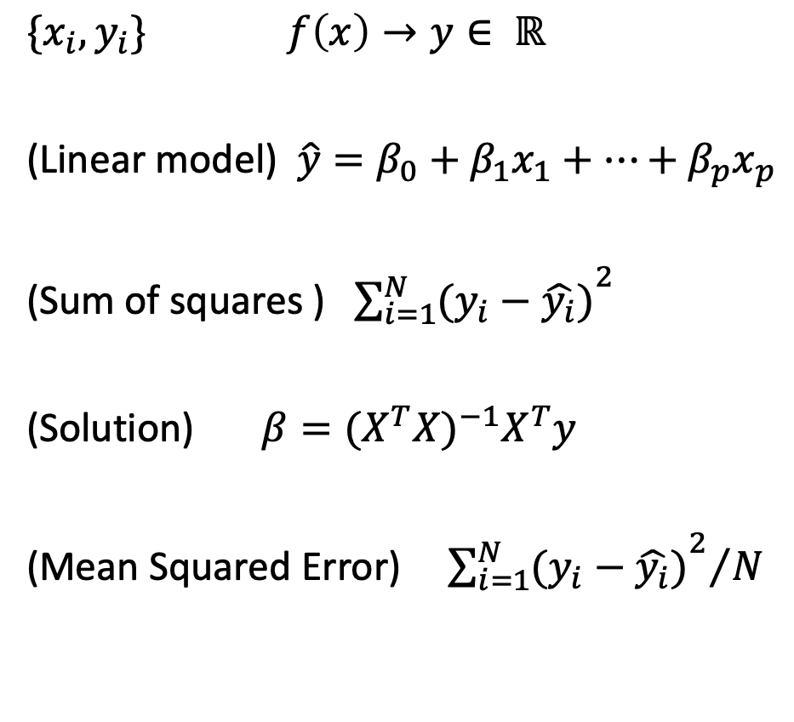
General Strategy
1. Machine Learning Basics
Linear Regression Example
Problem Setting
Model / Predictive Function
Cost / Loss Function
Parameter Estimation (Learning)
Model Validation / Generalization
$\{x_{i},y_{i}\}$ $f\left(x\right)→y∈ ℝ$
(Linear model) $\hat{y}=β_{0}+β_{1}x_{1}+…+β_{p}x_{p}$
(Sum of squares ) ${\sum_{i=1}^{N}{(y_{i}−\hat{y_{i}})}}^{2}$
(Solution) $β={(X^{T}X)}^{−1}X^{T}y$
(Mean Squared Error) ${{ \sum_{i=1}^{N}{(y_{i}−\hat{y_{i}})}}^{2}}/N$

Slide 9
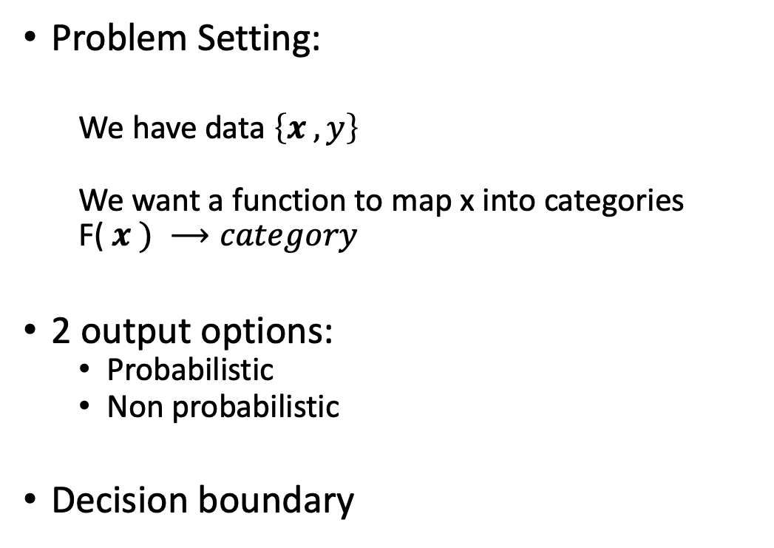
Classification
1. Machine Learning Basics
Problem Setting:
We have data $\left\{x , y\right\}$
We want a function to map x into categories
F($x ) ⟶category$
2 output options:
Probabilistic
Non probabilistic
Decision boundary

Slide 10
Evaluating a classification task
1. Machine Learning Basics
Confusion Matrix

Slide 11
Metric of evaluation
1. Machine Learning Basics
Accuracy: Percentage of correct predictions
93.75% accuracy

Slide 12
Model Validation / Generalization
1. Machine Learning Basics
Splitting the Data:
1st case:
2nd case:
Training
Testing
Training
Validation
Testing

Slide 13
Cross Validation
1. Machine Learning Basics
Leave-one-out Cross Validation
N=9
1
2
3
4
5
6
7
8
9
1
2
3
4
5
6
7
8
9
1
2
3
4
5
6
7
8
9
.
.
.
Training
Testing

Slide 14
Cross Validation
1. Machine Learning Basics
K-fold Cross Validation
N=9
K=3
1 2 3
4 5 6
7 8 9
1 2 3
4 5 6
7 8 9
1 2 3
4 5 6
7 8 9
Training
Testing

Slide 15
Cross Validation
1. Machine Learning Basics
Monte Carlo Cross Validation
N=10
70% train
30% test
10 4 7 3 6 1 9
2 8 5
4 2 7 9 5 8 6
10 1 3
2 1 7 10 6 8 3
4 9 5
5 10 4 3 8 1 9
6 7 2
.
.
.
Training
Testing

Slide 16
Sections
Machine Learning Basics
Logistic Regression
Basis Functions
Softmax Regression
Regularization
Decision Tree
Random Forest

Slide 17
Logistic Regression
2. Logistic Regression
= Logit model
Setting?
Predictive Function?
Loss Function?
Parameter Estimation?
Model Validation
Notes:
Lab Ex. 1 -> 1part: gradient descent, 2part: decision boundary, 3part: Validation, 4part: Cross Validation

Slide 18
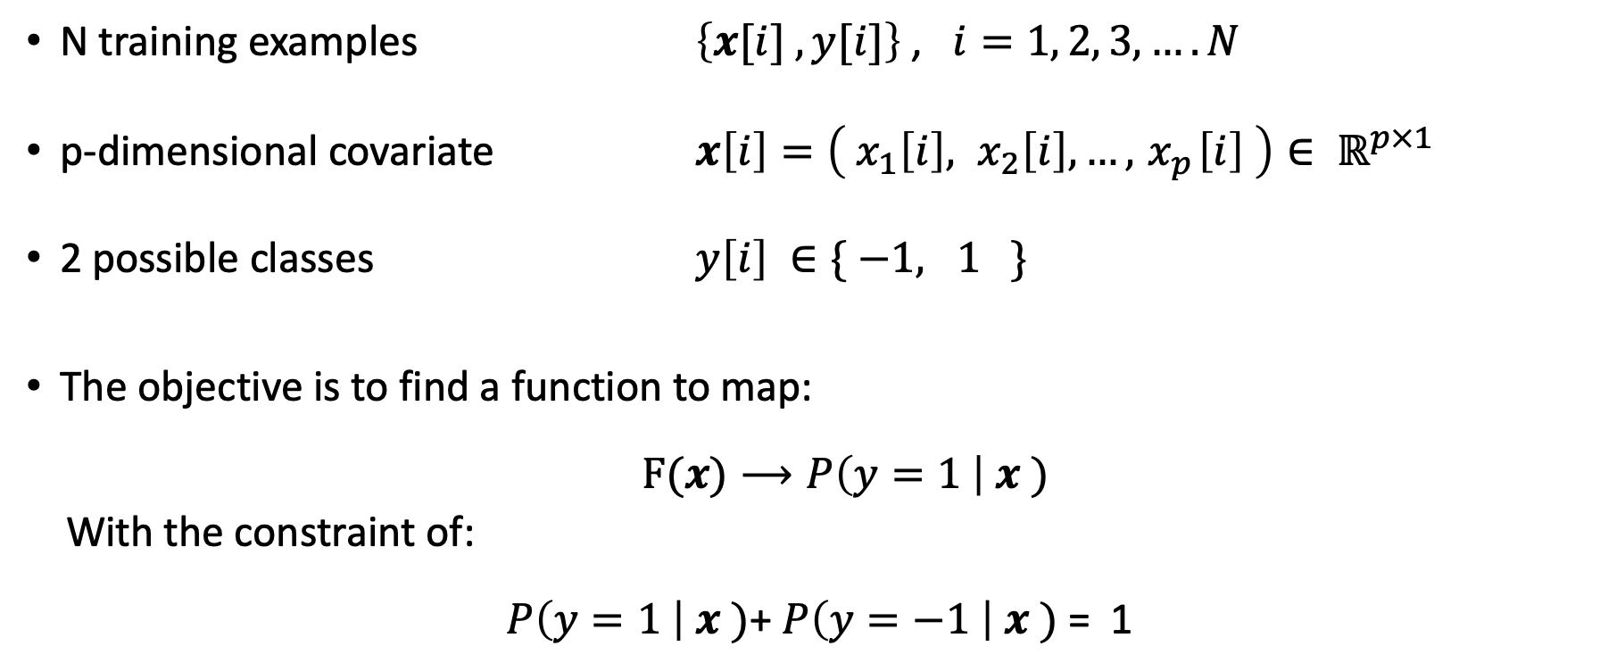
Setting
2. Logistic Regression
N training examples $\left\{x[i] , y[i]\right\}$ , $i=1, 2, 3,…. N$
p-dimensional covariate $x\left[i\right]=\left({ x}_{1}\left[i\right], x_{2}\left[i\right], …,{ x}_{p}\left[i\right] \right)∈ ℝ^{p×1}$
2 possible classes $y\left[i\right] ∈\{ −1, 1 \}$
The objective is to find a function to map:
$F(x)⟶P\left(y=1 \right| x )$
With the constraint of:
$P\left(y=1 \right| x )$+ $P\left(y=−1 \right| x )$= 1
Notes:
Lab Ex. 1 -> 1part: gradient descent, 2part: decision boundary, 3part: Validation, 4part: Cross Validation

Slide 19
Logistic Regression
2. Logistic Regression
= Logit model
Setting
Predictive Function?
Loss Function?
Parameter Estimation?
Model Validation
Notes:
Lab Ex. 1 -> 1part: gradient descent, 2part: decision boundary, 3part: Validation, 4part: Cross Validation

Slide 20
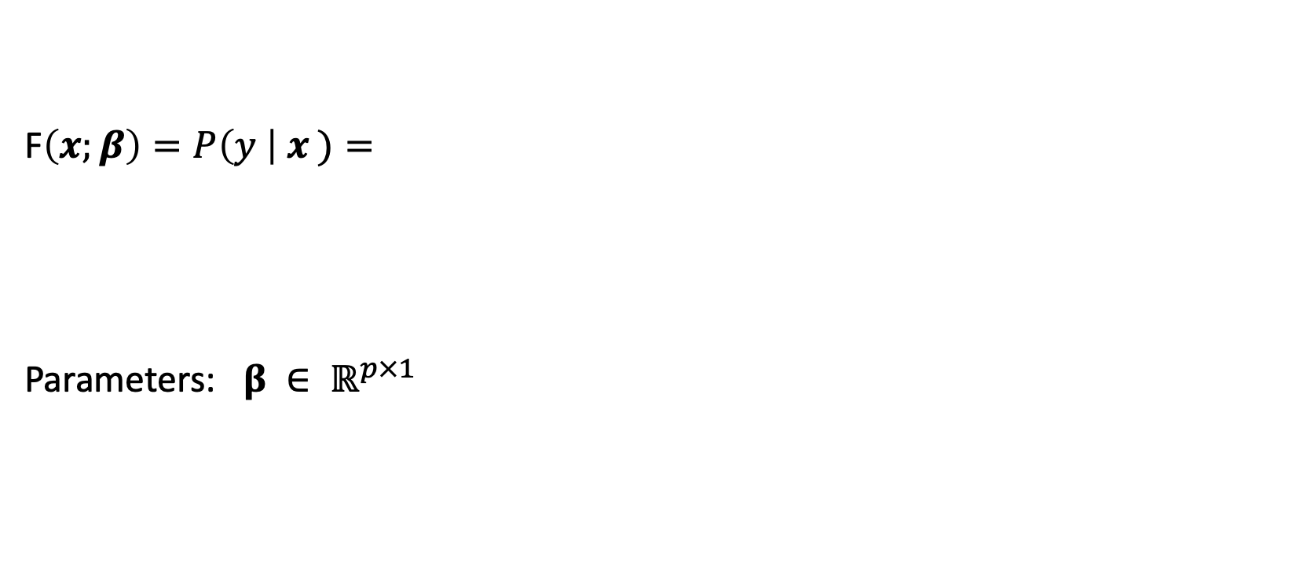
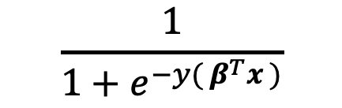
Predictive Function
2. Logistic Regression
F$\left(x;β\right)=P\left(y \right| x )=$
Parameters: $β ∈ ℝ^{p×1}$
$$\frac{1}{1+e^{−y( β^{T}x )}}$$
Notes:
Lab Ex. 1 -> 1part: gradient descent, 2part: decision boundary, 3part: Validation, 4part: Cross Validation

Slide 21
Logistic Regression
2. Logistic Regression
= Logit model
Setting
Predictive Function
Loss Function?
Parameter Estimation?
Model Validation
Notes:
Lab Ex. 1 -> 1part: gradient descent, 2part: decision boundary, 3part: Validation, 4part: Cross Validation

Slide 22
Loss Function
2. Logistic Regression
Loss is a function over the parameters
Should be differentiable and convex
Options:
Classification error ->not differentiable
?
Notes:
Lab Ex. 1 -> 1part: gradient descent, 2part: decision boundary, 3part: Validation, 4part: Cross Validation

Slide 23
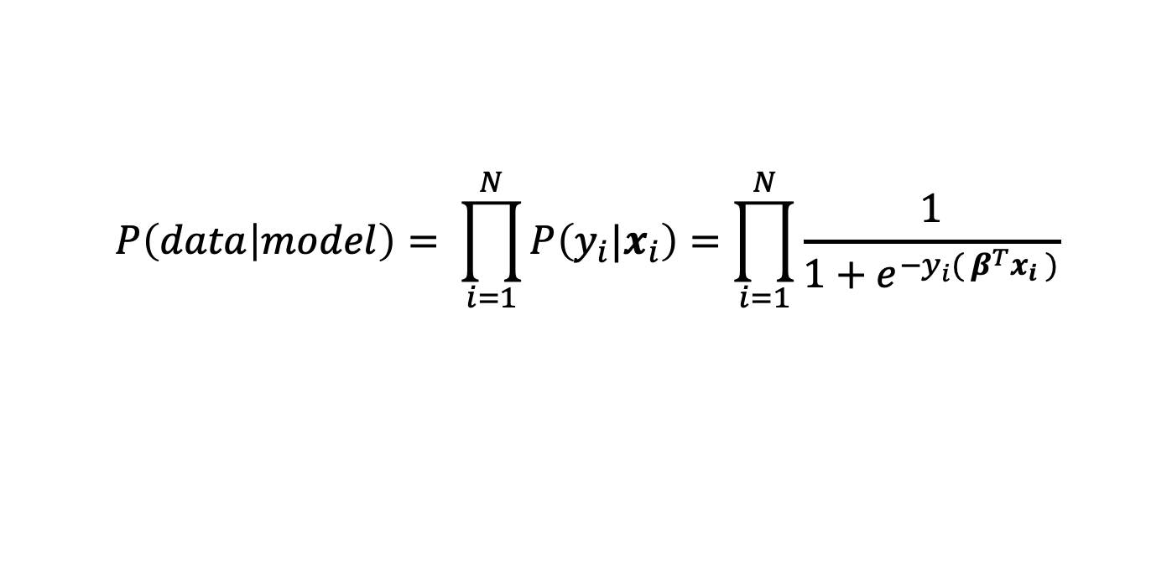
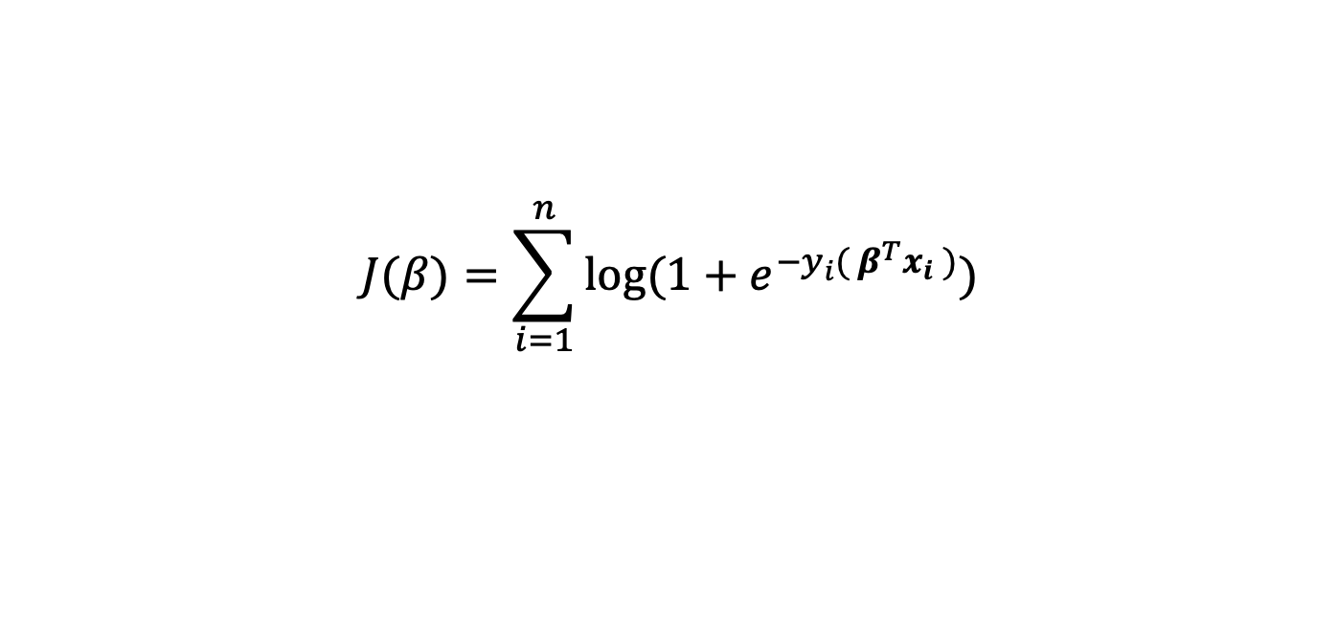
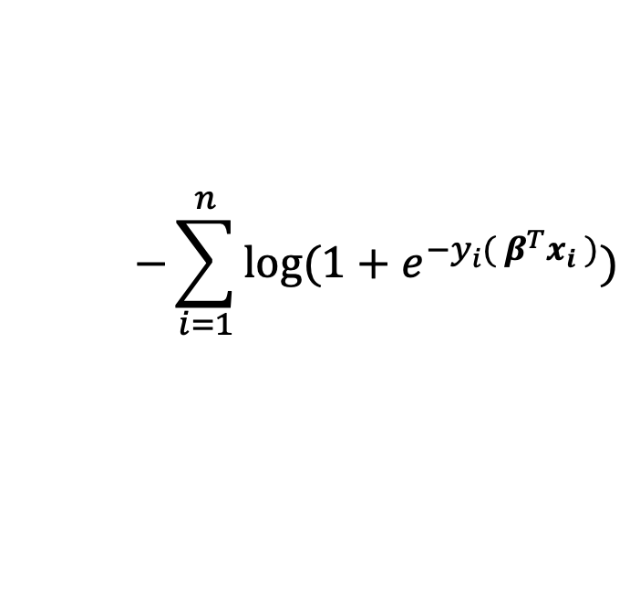
Maximum Likelihood Estimation
2. Logistic Regression
Likelihood:
Log likelihood:
$$P\left(data | model\right)= \prod_{i=1}^{N}{P\left({y_{i}|x}_{i}\right)=\prod_{i=1}^{N}{\frac{1}{1+e^{−y_{i}( β^{T}x_{i} )}}}}$$
Loss function:
$$−\sum_{i=1}^{n}{log(1+e^{−y_{i}( β^{T}x_{i} )})}$$
$$J(β)=\sum_{i=1}^{n}{log(1+e^{−y_{i}( β^{T}x_{i} )})}$$
Notes:
Lab Ex. 1 -> 1part: gradient descent, 2part: decision boundary, 3part: Validation, 4part: Cross Validation

Slide 24
Logistic Regression
2. Logistic Regression
= Logit model
Setting
Predictive Function
Loss Function
Parameter Estimation?
Model Validation
Notes:
Lab Ex. 1 -> 1part: gradient descent, 2part: decision boundary, 3part: Validation, 4part: Cross Validation

Slide 25
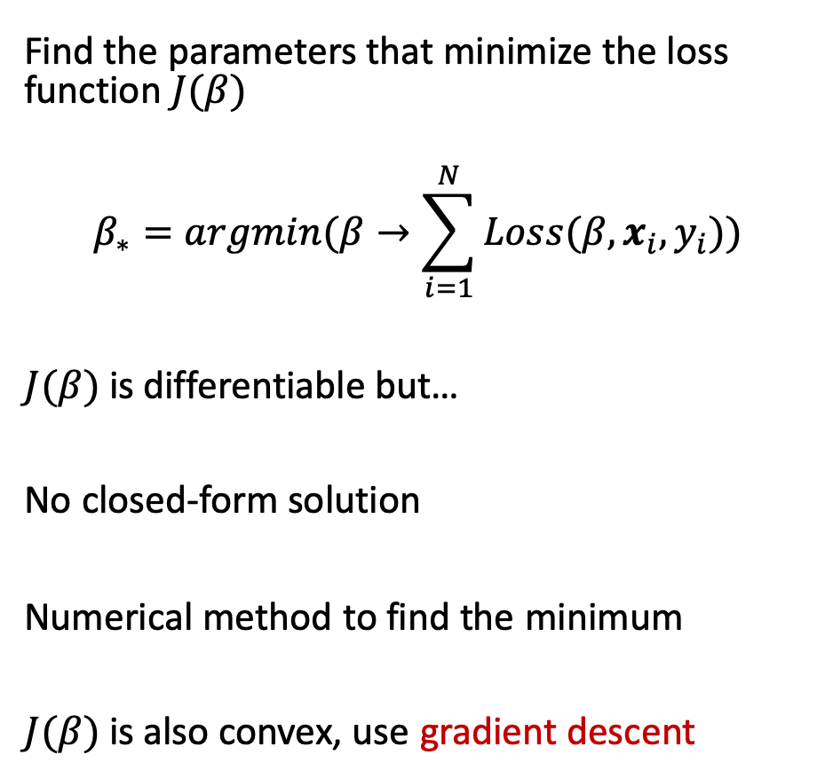
Parameter estimation
2. Logistic Regression
Find the parameters that minimize the loss function $J(β)$
$$β_{∗}=argmin(β→\sum_{i=1}^{N}{Loss(β,x_{i},y_{i})})$$
$J(β)$ is differentiable but…
No closed-form solution
Numerical method to find the minimum
$J(β)$ is also convex, use gradient descent
Notes:
Lab Ex. 1 -> 1part: gradient descent, 2part: decision boundary, 3part: Validation, 4part: Cross Validation

Slide 26
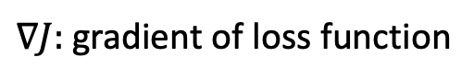
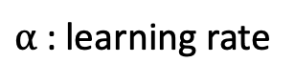
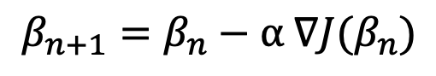
Gradient Descent
2. Logistic Regression
Update equation:
$$β_{n+1}=β_{n}−α ∇J(β_{n})$$
$α$: learning rate
$∇J:$ gradient of loss function
Notes:
Lab Ex. 1 -> 1part: gradient descent, 2part: decision boundary, 3part: Validation, 4part: Cross Validation

Slide 27
Logistic Regression
2. Logistic Regression
= Logit model
Setting
Predictive Function
Loss Function
Parameter Estimation
Model Validation
Notes:
Lab Ex. 1 -> 1part: gradient descent, 2part: decision boundary, 3part: Validation, 4part: Cross Validation

Slide 28
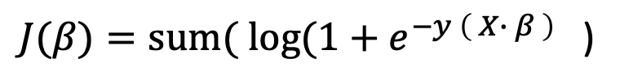
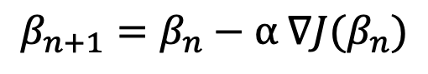
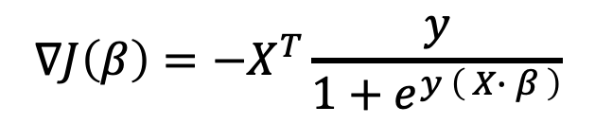
Lab 1
2. Logistic Regression
Implement logistic regression from scratch
Remember:
Loss function
Gradient Function
Gradient descent update
Matrix multiplication in R
%*%
$J(β)=sum( log(1+e^{−y \left( X∙ β \right)}$)
$$∇J\left(β\right)=−X^{T}\frac{y}{1+e^{y \left( X∙ β \right)}}$$
$$β_{n+1}=β_{n}−α ∇J(β_{n})$$
Notes:
Lab Ex. 1 -> 1part: gradient descent, 2part: decision boundary, 3part: Validation, 4part: Cross Validation

Slide 29
Sections
Machine Learning Basics
Logistic Regression
Basis Functions
Softmax Regression
Regularization
Decision Tree
Random Forest

Slide 30
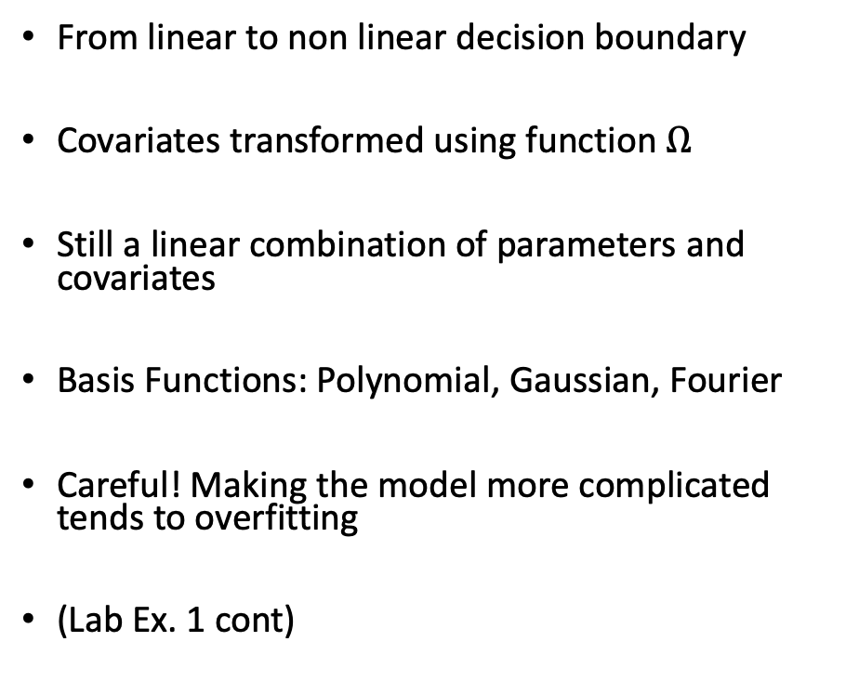
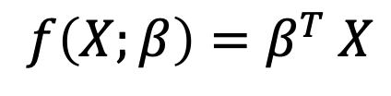
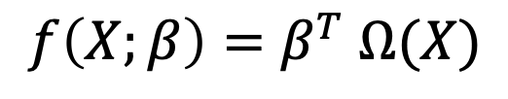
Basis Functions
3. Basis Functions
From linear to non linear decision boundary
Covariates transformed using function $Ω$
Still a linear combination of parameters and covariates
Basis Functions: Polynomial, Gaussian, Fourier
Careful! Making the model more complicated tends to overfitting
(Lab Ex. 1 cont)
$${f\left(X;β\right)=β}^{T} X$$
$${f\left(X;β\right)=β}^{T} Ω(X)$$
Notes:
Lab Ex. 1 -> 5part: polynomial expansion of design matrix, 6part: choose best degree of polynomial

Slide 31
Sections
Machine Learning Basics
Logistic Regression
Basis Functions
Softmax Regression
Regularization
Decision Tree
Random Forest

Slide 32
Softmax Regression
4. Softmax Regression
= Multinomial Logistic Regression
= Multinomial Logit Model
Setting?
Predictive Function?
Loss Function?
Parameter Estimation?
Model Validation
Notes:
Lab Ex. 1 -> 5part: polynomial expansion of design matrix, 6part: choose best degree of polynomial

Slide 33
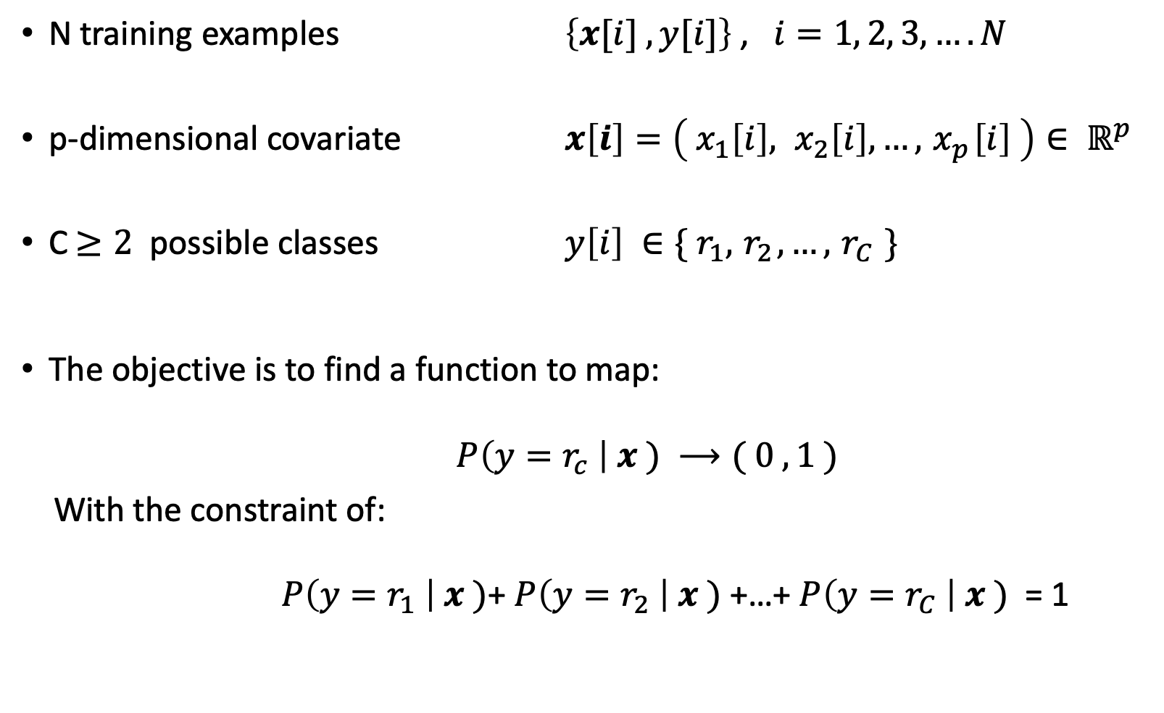
Setting
4. Softmax Regression
N training examples $\left\{x[i] , y[i]\right\}$ , $i=1, 2, 3,…. N$
p-dimensional covariate $x\left[i\right]=\left({ x}_{1}\left[i\right], x_{2}\left[i\right], …,{ x}_{p}\left[i\right] \right)∈ ℝ^{p}$
C$≥2$ possible classes $y\left[i\right] ∈\{ r_{1},{ r}_{2},…,{ r}_{C} \}$
The objective is to find a function to map:
$P\left(y=r_{c} \right| x ) ⟶( 0 ,1 )$
With the constraint of:
$P\left(y=r_{1} \right| x )$+ $P\left(y=r_{2} \right| x )$+…+ $P\left(y=r_{C} \right| x )$ = 1
Notes:
Lab Ex. 1 -> 5part: polynomial expansion of design matrix, 6part: choose best degree of polynomial

Slide 34
Softmax Regression
4. Softmax Regression
= Multinomial Logistic Regression
= Multinomial Logit Model
Setting
Predictive Function?
Loss Function?
Parameter Estimation?
Model Validation
Notes:
Lab Ex. 1 -> 5part: polynomial expansion of design matrix, 6part: choose best degree of polynomial

Slide 35
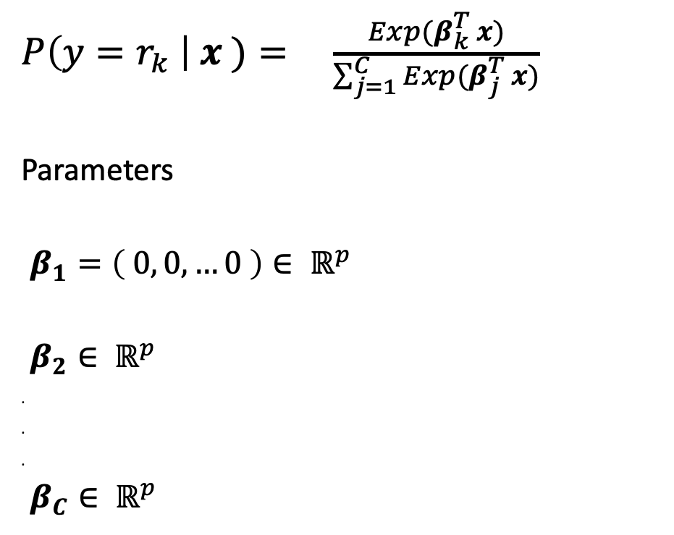
Predictive Function
4. Softmax Regression
$P\left(y=r_{k} \right| x )= \frac{Exp(β_{k}^{T} x)}{\sum_{j=1}^{C}{Exp(β_{j}^{T} x)}}$
Parameters
.$β_{1}=\left( 0, 0,…0 \right)∈ ℝ^{p}$
.$β_{2}∈ ℝ^{p}$
.
.
.
.$β_{C}∈ ℝ^{p}$
Notes:
Lab Ex. 1 -> 5part: polynomial expansion of design matrix, 6part: choose best degree of polynomial

Slide 36
Softmax Regression
4. Softmax Regression
= Multinomial Logistic Regression
= Multinomial Logit Model
Setting
Predictive Function
Loss Function?
Parameter Estimation?
Model Validation
Notes:
Lab Ex. 1 -> 5part: polynomial expansion of design matrix, 6part: choose best degree of polynomial

Slide 37
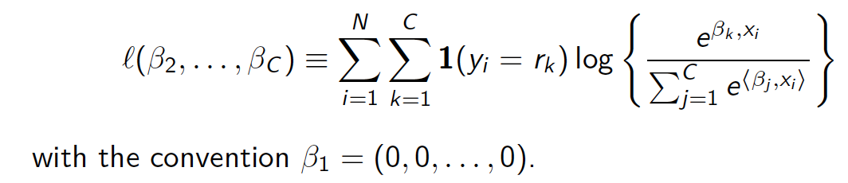
Loss Function
4. Softmax Regression
Probabilistic model -> Likelihood
The log likelihood is:
We want a loss function -> negative log-likelihood (Cross-Entropy)
Notes:
Lab Ex. 1 -> 5part: polynomial expansion of design matrix, 6part: choose best degree of polynomial

Slide 38
Softmax Regression
4. Softmax Regression
= Multinomial Logistic Regression
= Multinomial Logit Model
Setting
Predictive Function
Loss Function
Parameter Estimation?
Model Validation
Notes:
Lab Ex. 1 -> 5part: polynomial expansion of design matrix, 6part: choose best degree of polynomial

Slide 39
Parameter Estimation
4. Softmax Regression
The negative log-likelihood or cross entropy loss is differentiable and convex.
Use gradient descent to find the parameters.
Notes:
Lab Ex. 1 -> 5part: polynomial expansion of design matrix, 6part: choose best degree of polynomial

Slide 40
Softmax Regression
4. Softmax Regression
= Multinomial Logistic Regression
= Multinomial Logit Model
Setting
Predictive Function
Loss Function
Parameter Estimation
Model Validation
To do: Lab Ex.
Notes:
Lab Ex. 1 -> 5part: polynomial expansion of design matrix, 6part: choose best degree of polynomial

Slide 41
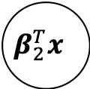
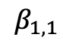
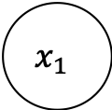
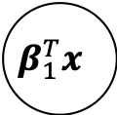
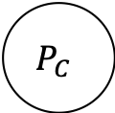
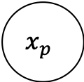
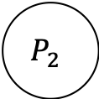
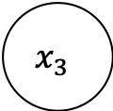
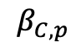

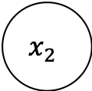
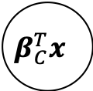
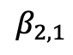
Relation to Neural Networks
4. Softmax Regression
Last layer of many deep learning classifiers
#classes
Softmax layer
P
r
o
b
a
b
i
l
i
t
i
e
s
$$x_{1}$$
$$β_{1,1}$$
$$β_{1}^{T}x$$
$$P_{1}$$
C
o
v
a
r
i
a
t
e
s
$$β_{2,1}$$
$$x_{2}$$
$$β_{2}^{T}x$$
$$P_{2}$$
.
.
.
$$x_{3}$$
$$β_{C}^{T}x$$
$$P_{C}$$
.
.
.
$$β_{C,p}$$
$$x_{p}$$

Slide 42
Sections
Machine Learning Basics
Logistic Regression
Basis Functions
Softmax Regression
Regularization
Decision Tree
Random Forest

Slide 43
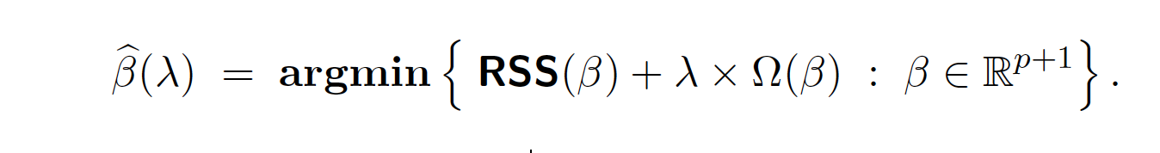
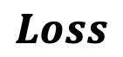
Regularization
5. Regularization
Regularization: Strategies to avoid overfitting
Large values in the coefficients are associated with overfitting…
Penalize the size of the coefficients 𝛃
Keep the value of Betas low -> Shrinkage methods
$$Loss$$
How much you penalize the size of the coefficients

Slide 44
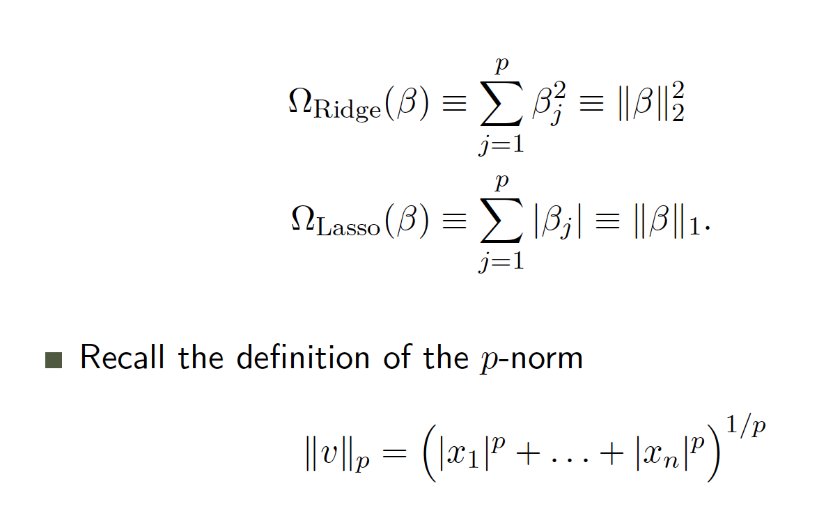
Ridge vs Lasso
5. Regularization
Difference is in the function that penalizes the coefficients
Ridge or L2-norm: Sum of squares
Lasso or L1-norm: Sum of absolute val.
P-norm definition:

Slide 45
Ridge vs Lasso
5. Regularization
Lasso
Ridge

Slide 46
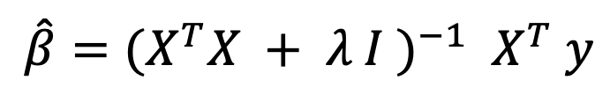
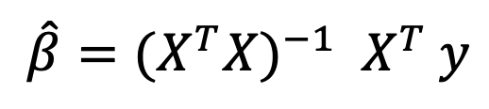
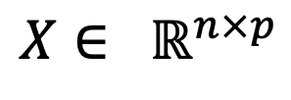
Why does it work?
5. Regularization
Data in real life is pathological (e.g. correlated, outliers)
Not interested in goodness of fit
Also, case p > n
Solution of linear regression:
Solution with L2 norm
$$\hat{β}={{(X}^{T}X)}^{−1}{ X}^{T} y$$
$$X∈ ℝ^{n×p}$$
$$\hat{β}={{(X}^{T}X + λ I )}^{−1}{ X}^{T} y$$

Slide 47
Lamda
5. Regularization
How much we penalize the size of coefficients
How to set 𝛌 ?
(Lab Ex)

Slide 48
Sections
Machine Learning Basics
Logistic Regression
Basis Functions
Softmax Regression
Regularization
Decision Tree
Random Forest

Slide 49
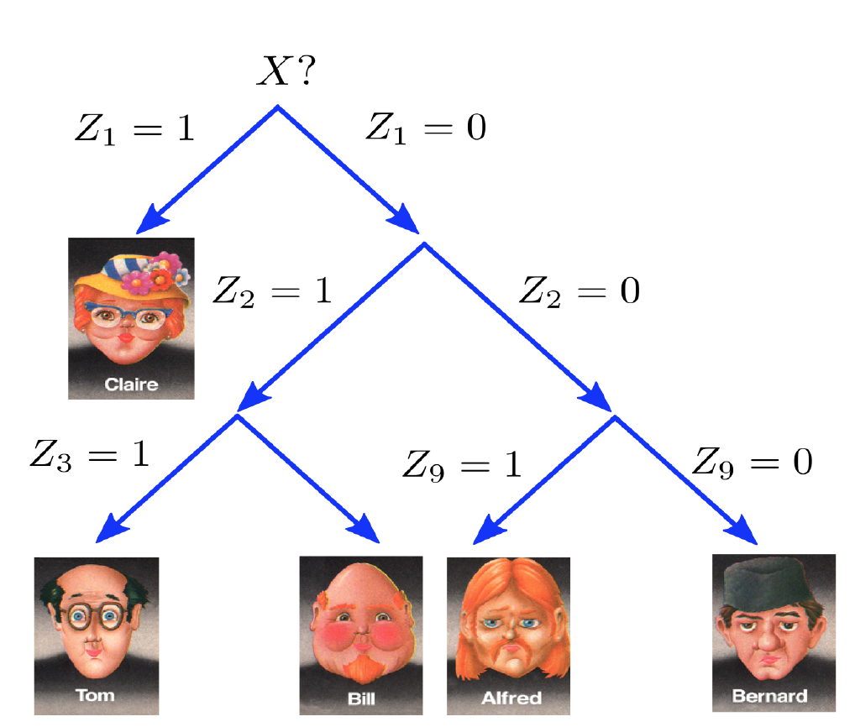
Decision Trees
6. Decision Trees

Slide 50
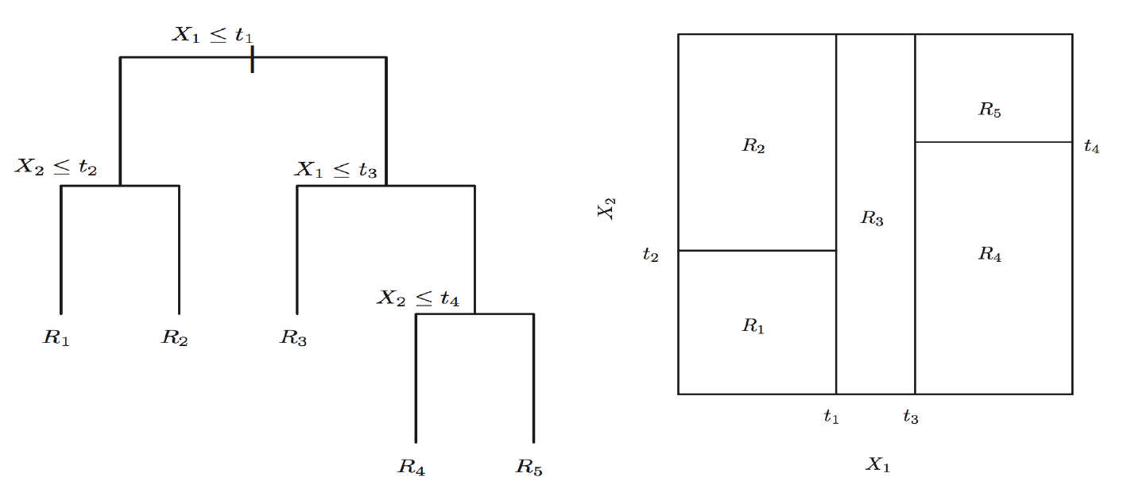
Decision Trees
6. Decision Trees
Not a linear combination, but a a recursive partition of the feature space

Slide 51
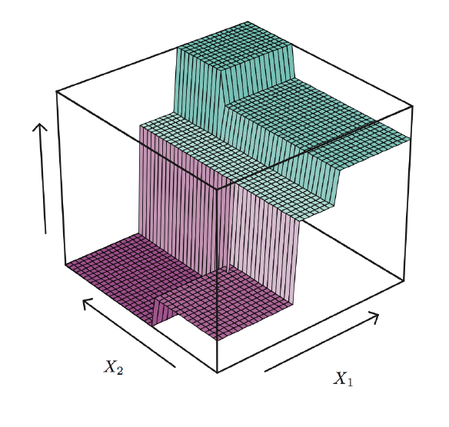
Decision Trees
6. Decision Trees
Not a linear combination, but a a recursive partition of the feature space

Slide 52
Decision Trees
6. Decision Trees
Setting: Classification
Predictive Function?
Loss Function?
Parameter Estimation?
Model Validation

Slide 53
Predictive Function
6. Decision Trees
X2
X1

Slide 54
Predictive Function
6. Decision Trees
X1>1
X2
( , )
X2>2
( 0 , 4 )
2
X1>2
X1>1.7
( 1 , 3 )
( 3 , 1 )
( 5 , 0 )
( 1 , 4 )
1
1.7
2
X1

Slide 55
Predictive Function
6. Decision Trees
X1>1
X2
( , )
X2>2
( 0 , 4 )
2
X1>2
X1>1.7
?
( 1 , 3 )
( 3 , 1 )
( 5 , 0 )
( 1 , 4 )
1
1.7
2
X1

Slide 56
Predictive Function
6. Decision Trees
X1>1
X2
( , )
X2>2
( 0 , 4 )
2
X1>2
X1>1.7
?
( 1 , 3 )
( 3 , 1 )
( 5 , 0 )
( 1 , 4 )
1
1.7
2
X1

Slide 57
Predictive Function
6. Decision Trees
X1>1
X2
( , )
X2>2
( 0 , 4 )
2
X1>2
X1>1.7
( 1 , 3 )
( 3 , 1 )
( 5 , 0 )
( 1 , 4 )
1
1.7
2
X1

Slide 58
Predictive Function
6. Decision Trees
X1>1
X2
( R5 )
( R4 )
X2>2
( R1 )
2
X1>2
X1>1.7
( R1 )
( R2 )
( R3 )
( R2 )
( R3 )
( R4 )
( R5 )
1
1.7
2
X1

Slide 59
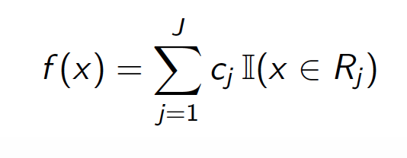
Predictive Function
6. Decision Trees
X2
( R5 )
( R4 )
2
( R1 )
( R2 )
( R3 )
1
1.7
2
X1

Slide 60
Decision Trees
6. Decision Trees
Setting: Classification
Predictive Function
Loss Function?
Parameter Estimation?
Model Validation

Slide 61
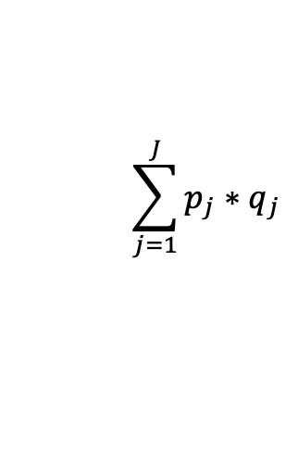
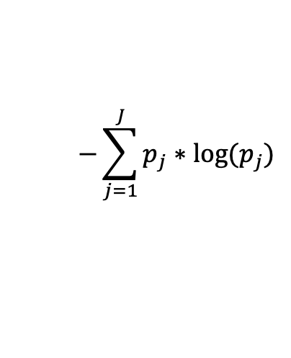
Loss function
6. Decision Trees
( p=success , q=failure )
Misclassification
Measurement of Purity
Gini Index:
Cross-Entropy:
X2
( 1 , 0 )
( 4/5, 1/5 )
$$\sum_{j=1}^{J}{p_{j}∗q_{j}}$$
2
$$−\sum_{j=1}^{J}{p_{j}∗{log⁡(p}_{j})}$$
( 1, 0 )
( 3/4 , 1/4)
( 3/4 , 1/4 )
1
1.7
2
X1

Slide 62
Decision Trees
6. Decision Trees
Setting: Classification
Predictive Function
Loss Function
Parameter Estimation?
Model Validation

Slide 63
Parameter Estimation
6. Decision Trees
= Growing a Tree
Parameters: Splits
Too expensive to find optimal splits (recursive nature)
Solution: Greedy approach
Algorithm:
At each step select the variable and the split that decreases the Gini index or Cross-Entropy the most.
Continue until a small number of training samples (e.g. ≤ 5) are left on each leaf

Slide 64
Decision Trees
6. Decision Trees
Setting: Classification
Predictive Function
Loss Function
Parameter Estimation
Model Validation

Slide 65
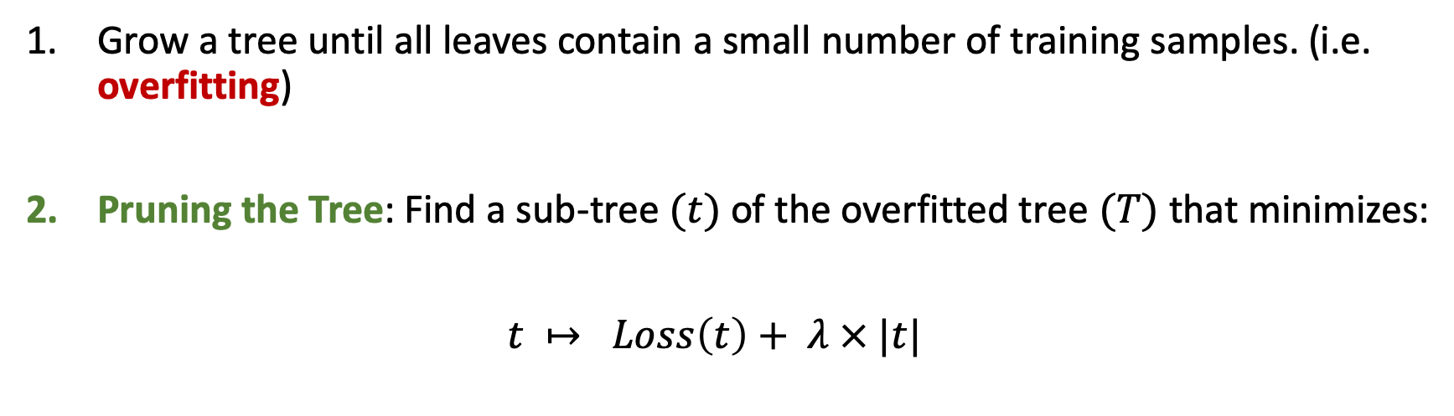
Growing a Tree in practice
6. Decision Trees
Grow a tree until all leaves contain a small number of training samples. (i.e. overfitting)
Pruning the Tree: Find a sub-tree $(t)$ of the overfitted tree $(T)$ that minimizes:
$t ↦ Loss\left(t\right)+ λ × |t|$
To do: Lab Ex. 3 (Tree)

Slide 66
Decision Trees
6. Decision Trees
Advantages
Easy to interpret
Can be displayed graphically
Disadvantages
Generally not good performance
Extremely sensitive to the training examples

Slide 67
Sections
Machine Learning Basics
Logistic Regression
Basis Functions
Softmax Regression
Regularization
Decision Tree
Random Forest

Slide 68
Bias vs. Variance
7. Random Forest
Prediction error can be decomposed into a bias error and a variance error

Slide 69
Bagging = Bootstrap Aggregating
7. Random Forest
Bootstrap samples: subsets of data chosen randomly with replacement.

Slide 70
Bagging = Bootstrap Aggregating
7. Random Forest
Notes:
Ensemble: take average. Advantage probabilistic output

Slide 71
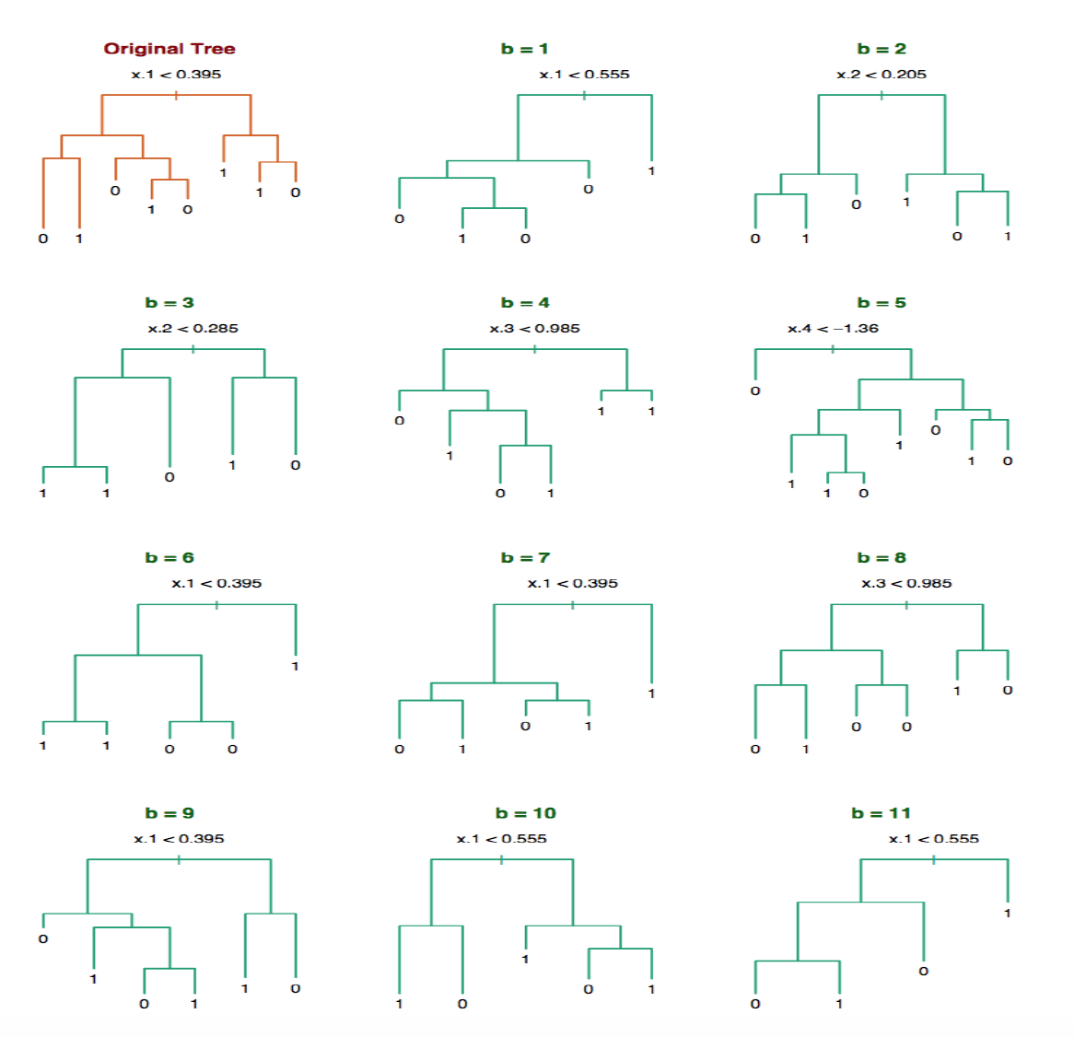
Bagging Trees
7. Random Forest
Notes:
1) Bagging logistic regression / linear regression? 2) How can we improve our bag of trees. The more different the better, How to make the trees more different?

Slide 72
Random Forest
7. Random Forest
Algorithm
Select m predictors at random from the p available predictors.
Pick the best variable/split-point among the m.
Split the node into two daughter nodes.
Iterate until a full tree is grown
*In practice m = sqrt(p) is often a reasonable choice
Bagging Trees with random subset of predictors
Make trees less correlated
Advantages
Easy to implement
No need of dummy variables
No need of scaling variables
Feature correlation ok
No hard model assumptions
General good performance
Probabilistic output
Variable Importance
(Lab Ex. 5)

Slide 73
Bonus Datasets (1)
Handwritten Digit Recognition
(mnist dataset)
28x28 pixels
0-255 pixel value

Slide 74
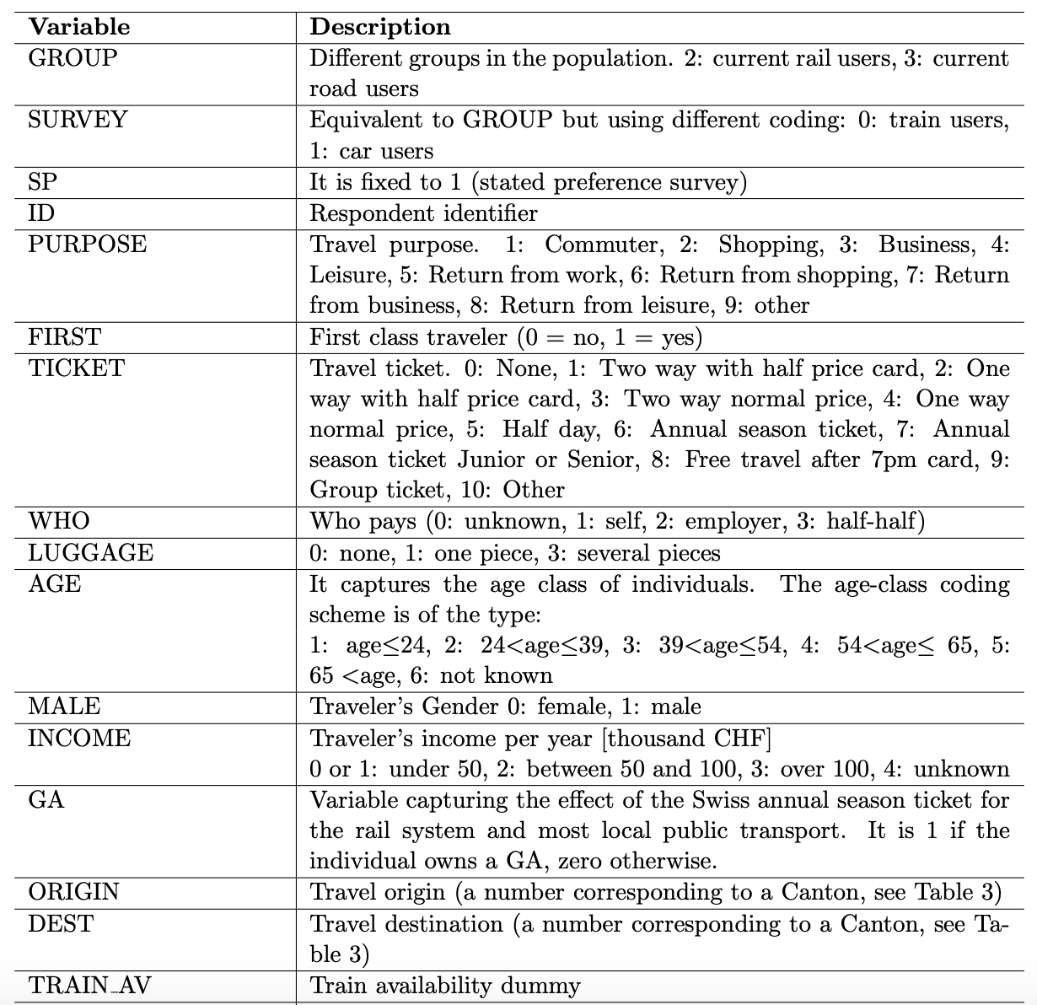
Bonus Datasets (2)
Swissmetro dataset
RP survey of mode choice in Switzerland
3 Labels: Rail, Swissmetro, Car

Slide 75
Sections
Machine Learning Basics
Logistic Regression
Basis Functions
Softmax Regression
Regularization
Decision Tree
Random Forest
Bonus: Neural Networks

Slide 76
Multilayer Perceptron
8. Neural Networks
From Softmax Regression to the Multilayer Perceptron
Linear combination + activation function

